Slide 1
Systems Analysis And Design
Chapter Four: Systems Design

Slide 2
Information system design involves tasks related to the specification of a detailed computer based solution: also called physical design to differentiate from data modeling, which is basically a logical design
System analysis emphasizes the business-problem while system design focuses on the technical or implementation concerns of the new system

Slide 3
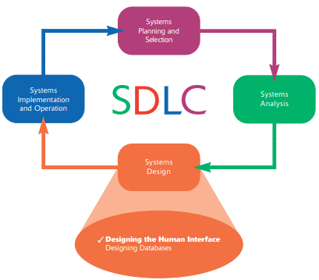

Slide 4
Designing Forms and Reports
A form is a business document containing some predefined data and often includes some areas where additional data are to be filled in
Examples of business forms are product order forms, employment applications, and class registration sheets

Slide 5
A report is a business document containing only predefined data; it is a passive document used solely for reading or viewing
Examples of reports are invoices, weekly sales summaries by region and salesperson, and a pie chart of population by age categories

Slide 6
Gaining an understanding of questions listed below is a required first step in the creation of any form or report
1. Who will use the form or report?
2. What is the purpose of the form or report?
3. When is the form or report needed and used?
4. Where does the form or report need to be delivered and used?
5. How many people need to use or view the form or report?

Slide 7
Design specifications are the major deliverables of designing forms and reports and are inputs to the system implementation and operation phase.
Design specifications have three sections:
1. Narrative overview
2. Sample design
3. Testing and usability assessment

Slide 8
Narrative Overview
The narrative overview provides a general overview of the characteristics of the target users, tasks, system, and environmental factors in which the form or report will be used
Its purpose is to explain to those who will actually develop the final form, why this form exists, and how it will be used so that they can make the appropriate implementation decisions

Slide 9


Slide 10
Sample Design
The sample design presents the look and feel of the actual form or report using some standard development tools.

Slide 11
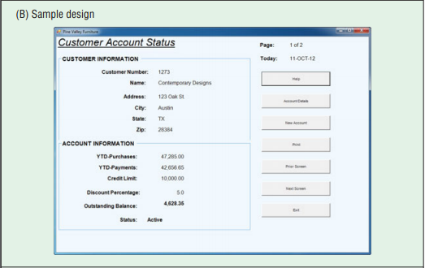

Slide 12
Testing and usability assessment
Here the focus is on assessment of the forms and reports using different parameters like consistency, accuracy and the like.

Slide 13
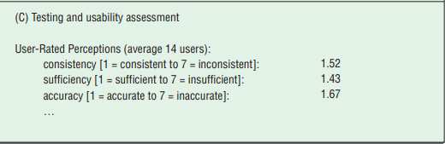

Slide 14
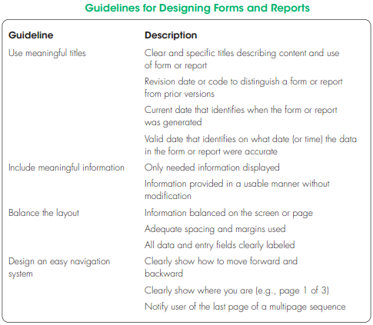

Slide 15
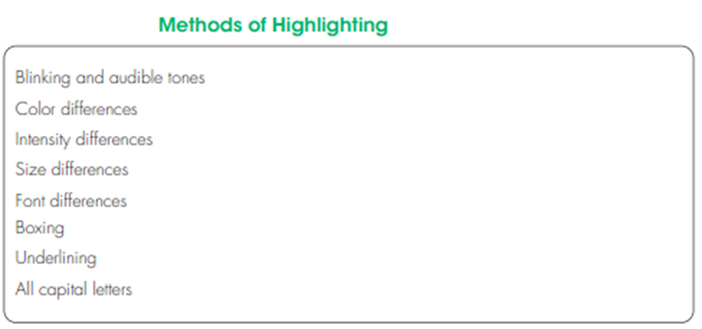

Slide 16
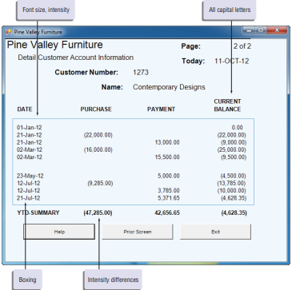

Slide 17
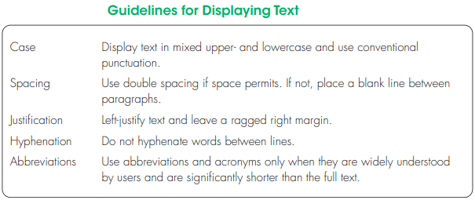

Slide 18
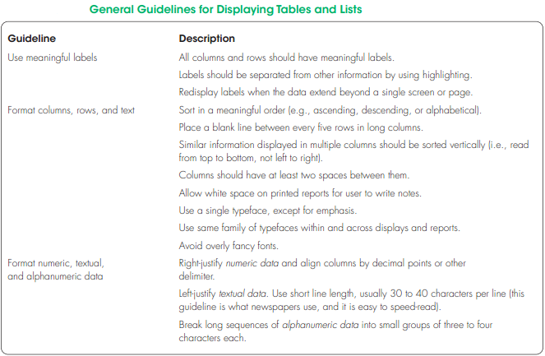

Slide 19
Designing Interfaces and Dialogues
Interface and dialogue design focuses on how information is provided to and captured from users
The grammatical rules followed by each person during a conversation are analogous to the human-computer interface
A good human-computer interface provides a uniform structure for finding, viewing, and invoking the different components of a system

Slide 20
Similar to designing forms and reports, the process of designing interfaces and dialogues is a user-focused activity
You follow a prototyping methodology of iteratively collecting information, constructing a prototype, assessing usability, and making refinements

Slide 21
Designing Interfaces
Designing Layouts
To ease user training and data recording, use standard formats for computer-based forms and reports similar to paper-based forms and reports for recording or reporting information
A typical paper-based form and its computer-based counterpart are shown in the next slide

Slide 22
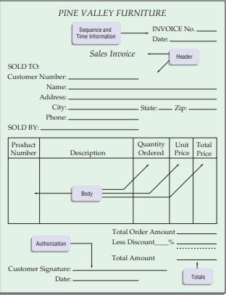
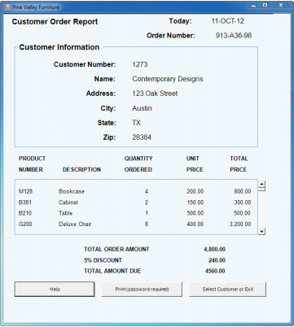

Slide 23
Structuring Data Entry
You should consider several guidelines when structuring data-entry fields on a form
See the guidelines for structuring data entry in the next slide

Slide 24
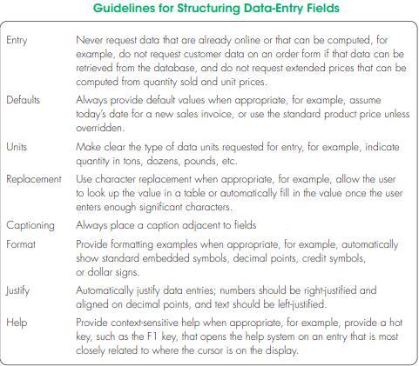

Slide 25
3. Controlling Data Input
One objective of interface design is to reduce data-entry errors
As data are entered into an information system, steps must be taken to ensure that the input is valid
Systems analysts are expected to anticipate the types of errors users may make and design features into the system’s interfaces to avoid, detect, and correct data-entry mistakes
See the guideline for detecting data errors in the next slide

Slide 26
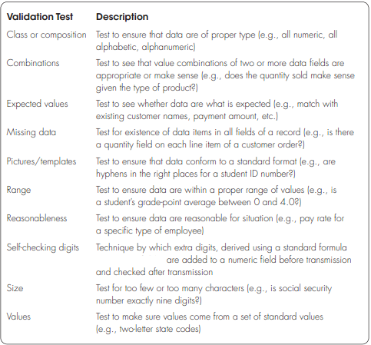

Slide 27
Designing Dialogues
The process of designing the overall sequences that users follow to interact with an information system is called dialogue design
A dialogue is the sequence in which information is displayed to and obtained from a user

Slide 28
The primary design guideline for designing dialogues is consistency; dialogues need to be consistent in sequence of actions, keystrokes, and terminology
In other words, use the same labels for the same operations on all screens and the same location of the same information on all displays.

Slide 29
Designing the Dialogue Sequence
Your first step in dialogue design is to define the sequence.
A method for designing and representing dialogues is dialogue diagramming.
Dialogue diagrams have only one symbol, a box with three sections; each box represents one display (which might be a full screen or a specific form or window) within a dialogue

Slide 30
The three sections of the box are used as follows
1. Top: Contains a unique display reference number used by other displays for referencing it
2. Middle: Contains the name or description of the display
3. Bottom: Contains display reference numbers that can be accessed from the current display
See the example in the next slide

Slide 31
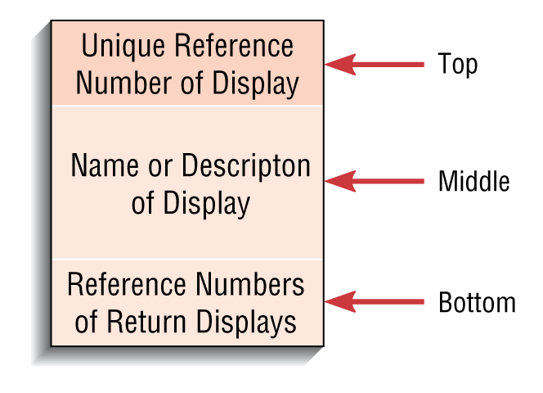

Slide 32
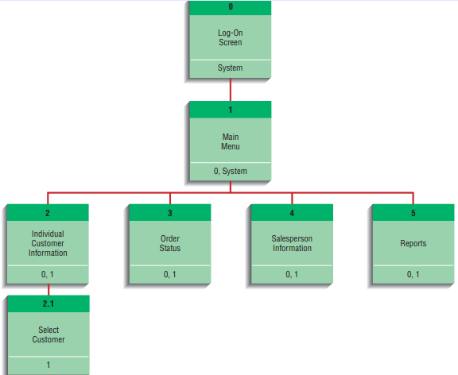

Slide 33
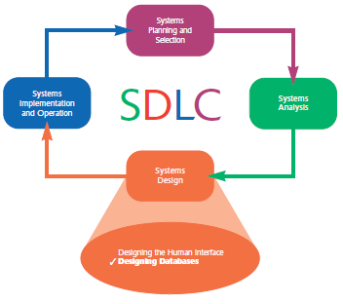

Slide 34
Deliverables and Outcomes
Logical database is the representation of data using a model like relational database model, which represents data in simple tables with common columns to link related tables.
Physical database is the representation of relations into files

Slide 35
Process of Database Design
Logical Design
Four key steps:
1. Develop a logical data model for each known user interface for the application using normalization principles
2. Combine normalized data requirements from all user interfaces into one consolidated logical database model
3. Translate the conceptual E-R data model for the application into normalized data requirements
4. Compare the consolidated logical database design with the translated E-R model and produce one final logical database model for the application

Slide 36
Process of Database Design
Physical Design
Based upon results of logical database design
Key decisions:
Choosing storage format for each attribute from the logical database model
Grouping attributes from the logical database model into physical records
Arranging related records in secondary memory (hard disks and magnetic tapes) so that records can be stored, retrieved, and updated rapidly
Selecting media and structures for storing data to make access more efficient

Slide 37
Relational Database Model
Data represented as a set of related tables or relations
Relation
A named, two-dimensional table of data. Each relation consists of a set of named columns and an arbitrary number of unnamed rows
Properties
Entries in cells are simple
Entries in columns are from the same set of values
Each row is unique
The sequence of columns can be interchanged without changing the meaning or use of the relation
The rows may be interchanged or stored in any sequence

Slide 38
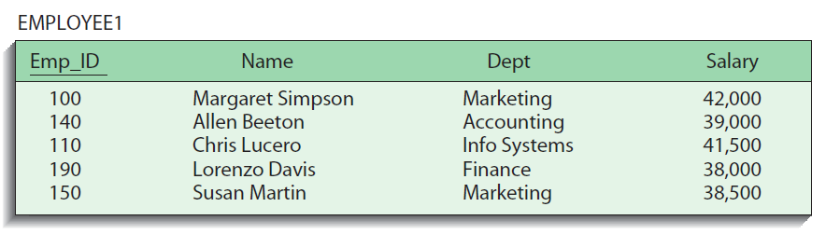
Relational Database Model
Well-Structured Relation
A relation that contains a minimum amount of redundancy and allows users to insert, modify, and delete the rows without errors or inconsistencies

Slide 39
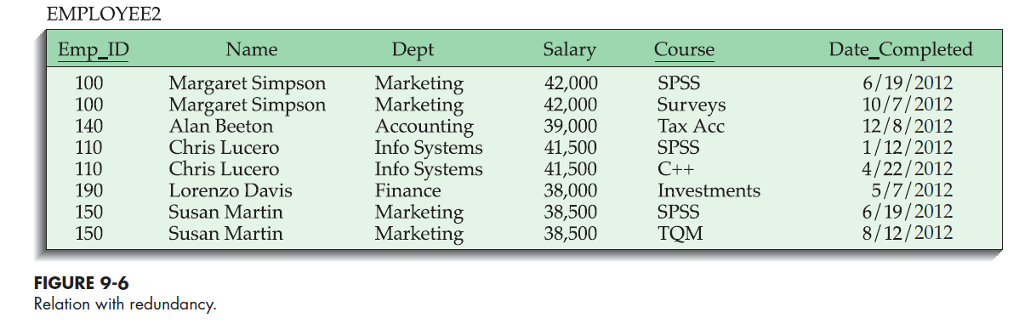
Normalization
The process of converting complex data structures into simple, stable data structures
Eliminates redundancy

Slide 40
Normalization
Second Normal Form (2NF)
Each non-primary key attribute is identified by the whole key (called full functional dependency)
Third Normal Form (3NF)
Non-primary key attributes do not depend on each other (called transitive dependencies)
The result of normalization is that every non-primary key attribute depends upon the whole primary key and nothing but the primary key.

Slide 41
Functional Dependencies and Primary Keys
Functional Dependency
A particular relationship between two attributes. For a given relation, attribute B is functionally dependent on attribute A if, for every valid value of A, that value of A uniquely determines the value of B.
Instances (or sample data) in a relation do not prove the existence of a functional dependency
Knowledge of problem domain is the most reliable method for identifying functional dependency

Slide 42
Functional Dependencies and Primary Keys
Second Normal Form (2NF)
A relation is in second normal form (2NF) if any of the following conditions apply:
The primary key consists of only one attribute
No non-primary key attribute exists in the relation
Every non-primary key attribute is functionally dependent on the full set of primary key attributes

Slide 43
Functional Dependencies and Primary Keys
Conversion to second normal form (2NF)
To convert a relation into 2NF, decompose the relation into new relations using the attributes called determinants that determine other attributes
The determinants become the primary key of the new relation

Slide 44
Functional Dependencies and Primary Keys
EMPLOYEE2 below is an example of a relation that is not in second normal form.
EMPLOYEE2(Emp_ID, Name, Dept, Salary, Course, Date_Completed)
The functional dependencies in this relation are the following:
Emp_ID:Name, Dept, Salary
Emp_ID, Course:Date_Completed

Slide 45
Functional Dependencies and Primary Keys
EMPLOYEE2 is decomposed into the following two relations:
EMPLOYEE1(Emp_ID, Name, Dept, Salary)
EMP_COURSE(Emp_ID, Course, Date_Completed)

Slide 46
Functional Dependencies and Primary Keys
Third Normal Form (3NF)
A relation is in third normal form (3NF) if it is in second normal form (2NF) and there are no functional (transitive) dependencies between two (or more) non-primary key attributes
To convert a relation into 3NF, decompose the relation into two relations using the two determinants

Slide 47
Functional Dependencies and Primary Keys
Consider the relation below:
SALES(Customer_ID, Customer_Name, Salesperson, Region)
The following functional dependencies exist in the SALES relation where Customer_ID is the primary key :
Customer_ID:Customer_Name, Salesperson, Region
Salesperson:Region (Each salesperson is assigned to a unique region.)

Slide 48
Functional Dependencies and Primary Keys
SALES relation is decomposed into two relations to convert it into 3NF as follows:
SALES1(Customer_ID, Customer_Name, Salesperson)
SPERSON(Salesperson, Region)

Slide 49
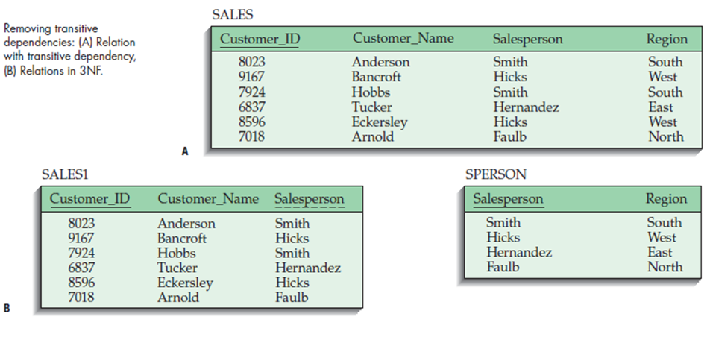

Slide 50
Functional Dependencies and Primary Keys
Foreign Key
An attribute that appears as a nonprimary key attribute in one relation and as a primary key attribute (or part of a primary key) in another relation
Referential Integrity
An integrity constraint specifying that the value (or existence) of an attribute in one relation depends on the value (or existence) of the same attribute in another relation

Slide 51
Transforming E-R Diagrams into Relations
It is useful to transform the conceptual data model into a set of normalized relations
Steps:
Represent entities
Represent relationships
Normalize the relations
Merge the relations

Slide 52
Transforming E-R Diagrams into Relations
Represent Entities
Each regular entity is transformed into a relation
The identifier of the entity type becomes the primary key of the corresponding relation
The primary key must satisfy the following two conditions
The value of the key must uniquely identify every row in the relation
The key should be non-redundant

Slide 53
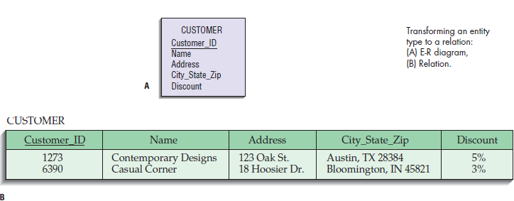

Slide 54
Transforming E-R Diagrams into Relations
Represent Relationships
Binary 1:N and 1:1 Relationships
A binary one-to-many (1:N) relationship in an E-R diagram is represented by adding the primary key attribute (or attributes) of the entity on the one side of the relationship as a foreign key in the relation that is on the many side of the relationship.
For a binary or unary one-to-one (1:1) relationship between the two entities A and B (for a unary relationship, A and B would be the same entity type), the relationship can be represented by any of the following choices:
Adding the primary key of A as a foreign key of B
Adding the primary key of B as a foreign key of A
Both of the above

Slide 55
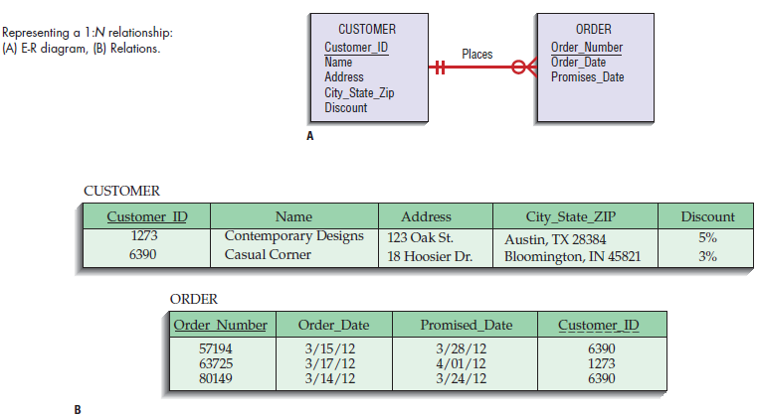

Slide 56
Transforming E-R Diagrams into Relations
Represent Relationships (continued)
Binary and Higher-Degree M:N Relationships
Suppose that a binary many-to-many (M:N) relationship (or associative entity) exists between two entity types A and B. For such a relationship, we create a separate relation C. The primary key of this relation is a composite key consisting of the primary key for each of the two entities in the relationship.

Slide 57
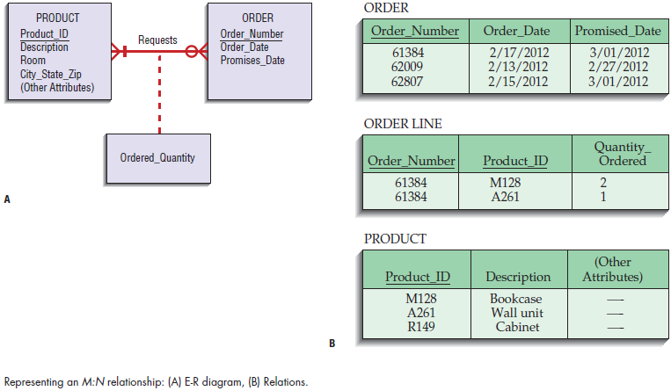

Slide 58
Transforming E-R Diagrams into Relations
Unary 1:N Relationships
Relationship between instances of a single entity type
Utilize a recursive foreign key
A foreign key in a relation that references the primary key values of that same relation
Unary M:N Relationships
Create a separate relation
Primary key of new relation is a composite of two attributes that both take their values from the same primary key

Slide 59
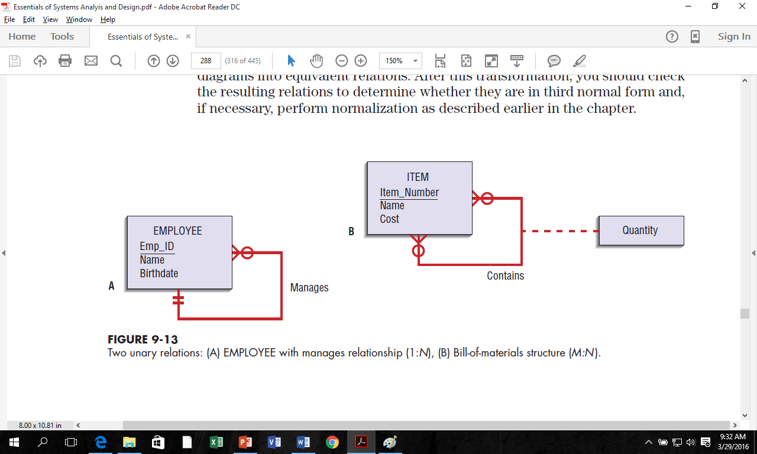
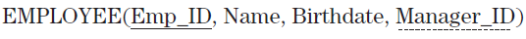


Slide 60
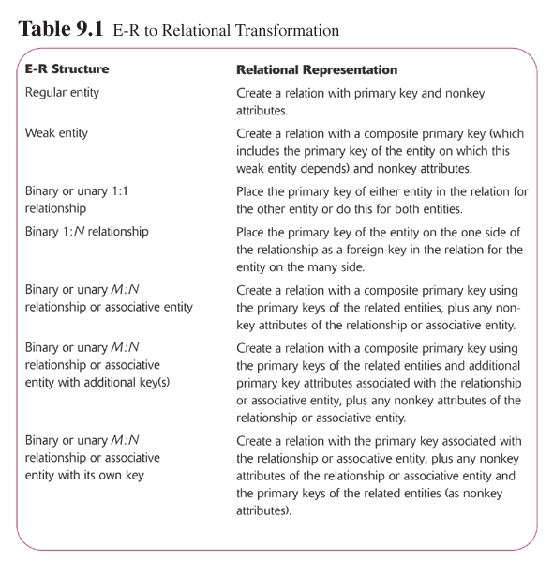

Slide 61
Transforming E-R Diagrams into Relations
Merging Relations (View Integration)
Purpose is to remove redundant relations
View Integration Problems
Synonyms
Two different names used for the same attribute
When merging, get agreement from users on a single, standard name
Homonyms
A single attribute name that is used for two or more different attributes
Resolve by creating a new name
Dependencies between nonkeys
Dependencies may be created as a result of view integration
In order to resolve, the new relation must be normalized

Slide 62
Physical Database Design
Physical Database Design is involved with how data are stored and related based on a particular DBMS.
It involves two major activities:
Designing Fields
Designing Physical Tables

Slide 63
Designing Fields
A field is the smallest unit of data recognized by database management systems
In general, each attribute from each normalized relation is represented as one or more fields
The basic decisions concerning a field are:
the type of data (or storage type) and
data integrity controls for the field.

Slide 64
Choosing Data Types
A data type is a coding scheme for representing organizational data.
The specific database management software to be used dictates which data type choices are available
Selecting a data type balances four objectives that will vary in degree of importance for different applications:
Minimize storage space
Represent all possible values of the field
Improve data integrity for the field
Support all data manipulations desired on the field

Slide 65
Controlling Data Integrity
The five popular data integrity control methods are:
default value: is the value a field will assume unless an explicit value is entered for the field
input mask: is a pattern of codes that restricts the width and possible values for each position within a field
range control: is a limited set of permissible values both numeric and alphabetic data may have
referential integrity: is a constraint specifying that the value (or existence) of an attribute in one relation depends on the value (or existence) of the same attribute in another relation
null value control: is a constraint that insures that mandatory fields are given a value.

Slide 66
Designing Physical Tables
A relational database is a set of related tables (tables are related by foreign keys referencing primary keys)
a physical table is a named set of rows and columns that specifies the fields in each row of the table.
A physical table may or may not correspond to one relation
Whereas normalized relations possess properties of well-structured relations, the design of a physical table has two goals different from those of normalization:
efficient use of secondary storage and
data-processing speed.

Slide 67
Designing Physical Tables
Denormalization is the process of splitting or combining normalized relations into physical tables based on affinity of use of rows and fields.
By placing data used together close to one another on disk, the number of disk I/O operations needed to retrieve all the data needed in a program is minimized.

Slide 68
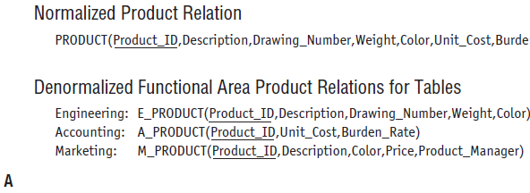
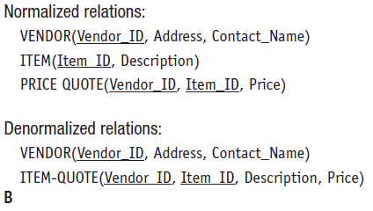
Designing Physical Tables

Slide 69
File Organization
File Organization is a technique for physically arranging the records of a file.
The basic three families of file organizations used in most file management environments are:
Sequential
indexed, and
hashed

Slide 70
Sequential File Organization
The rows in the file are stored in sequence according to a primary key value
To locate a particular row, a program must normally scan the file from the beginning until the desired row is located
Sequential files are fast if you want to process rows sequentially, but they are essentially impractical for random row retrievals
Deleting rows can cause wasted space or the need to compress the file
Adding or updating rows requires rewriting the file

Slide 71
Indexed File Organizations
The rows are stored either sequentially or nonsequentially, and an index is created that allows software to locate individual rows.
The main disadvantages of indexed file organizations are the extra space required to store the indexes and the extra time necessary to access and maintain indexes.

Slide 72
Hashed File Organizations
In hashed file organization, the address of each row is determined using an algorithm that converts a primary key value into a row address
rows are located nonsequentially as dictated by the hashing algorithm. Thus, sequential data processing is impractical.
On the other hand, retrieval of random rows is fast

Slide 73
